Slide 1

Kaggle Experience Sharing
Presented By Yifan Xie
21/09/2019

Slide 2
Outline
Hello Paris! – brief intro…
Kaggle Experience Sharing
Path to Gold/Top 1%
Organisation & Workflow
Feature Engineering & Feature Selection
Conclusion/Discussion

Slide 3
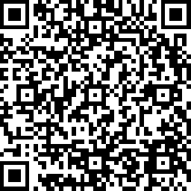
Feedback
https://docs.google.com/forms/d/e/1FAIpQLSdtjst3B-owxCFNYRUWgIgVBHGamVtirPw6otP6i5f8n6qVbA/viewform?usp=sf_link

Slide 4
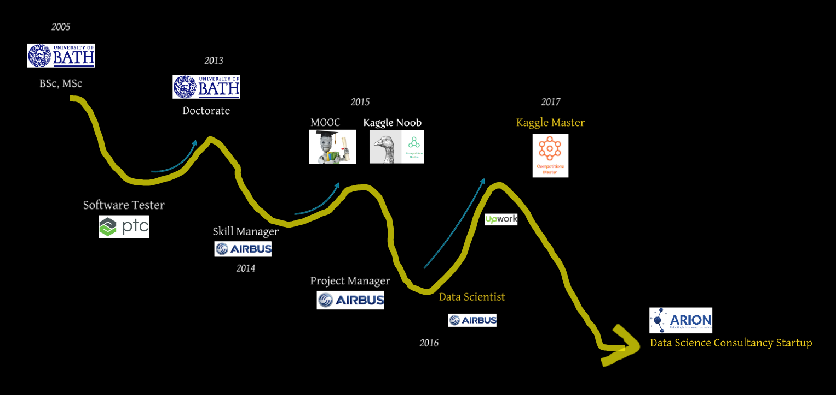
Self Introduction

Slide 5
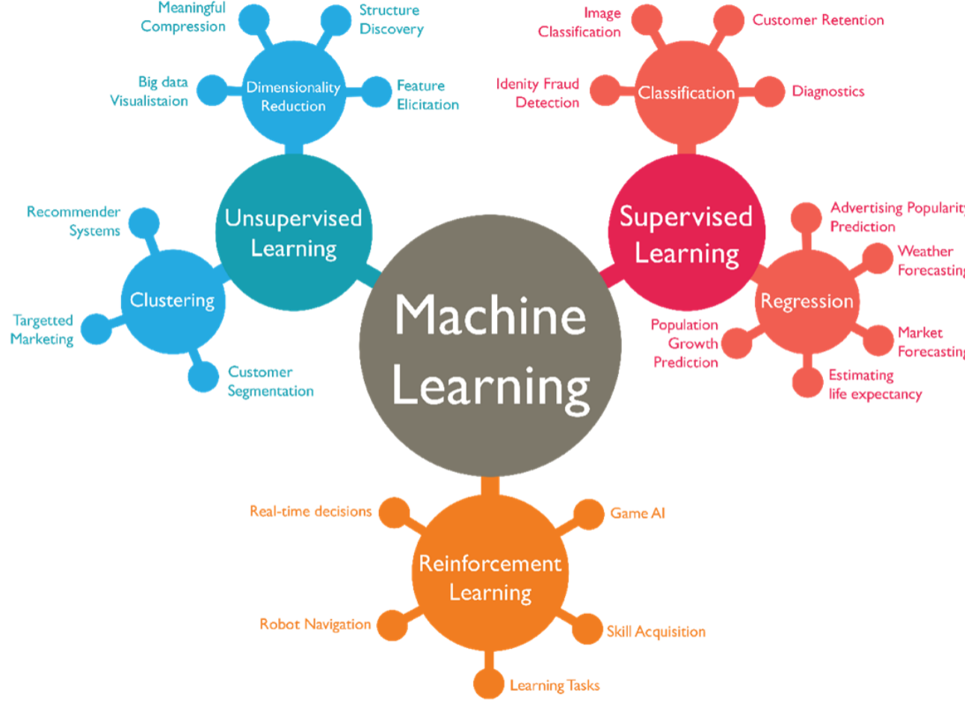
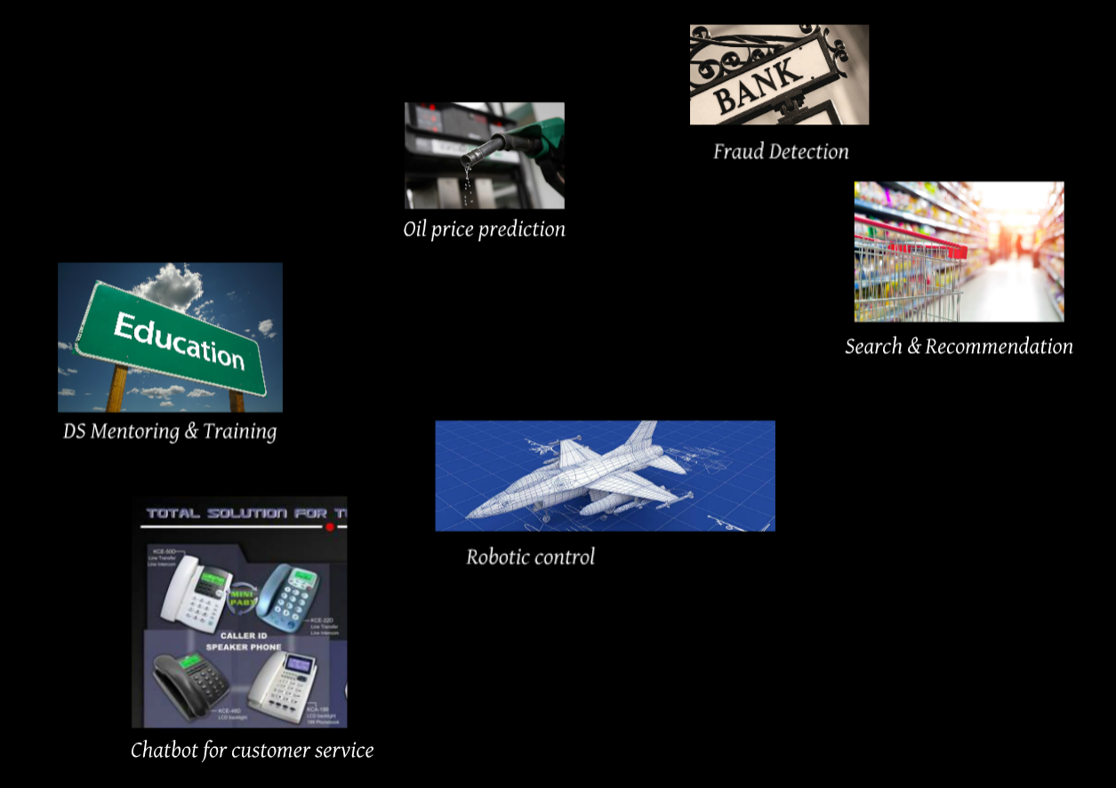
Kaggle Discussion
Too much to learn, too little time

Slide 6
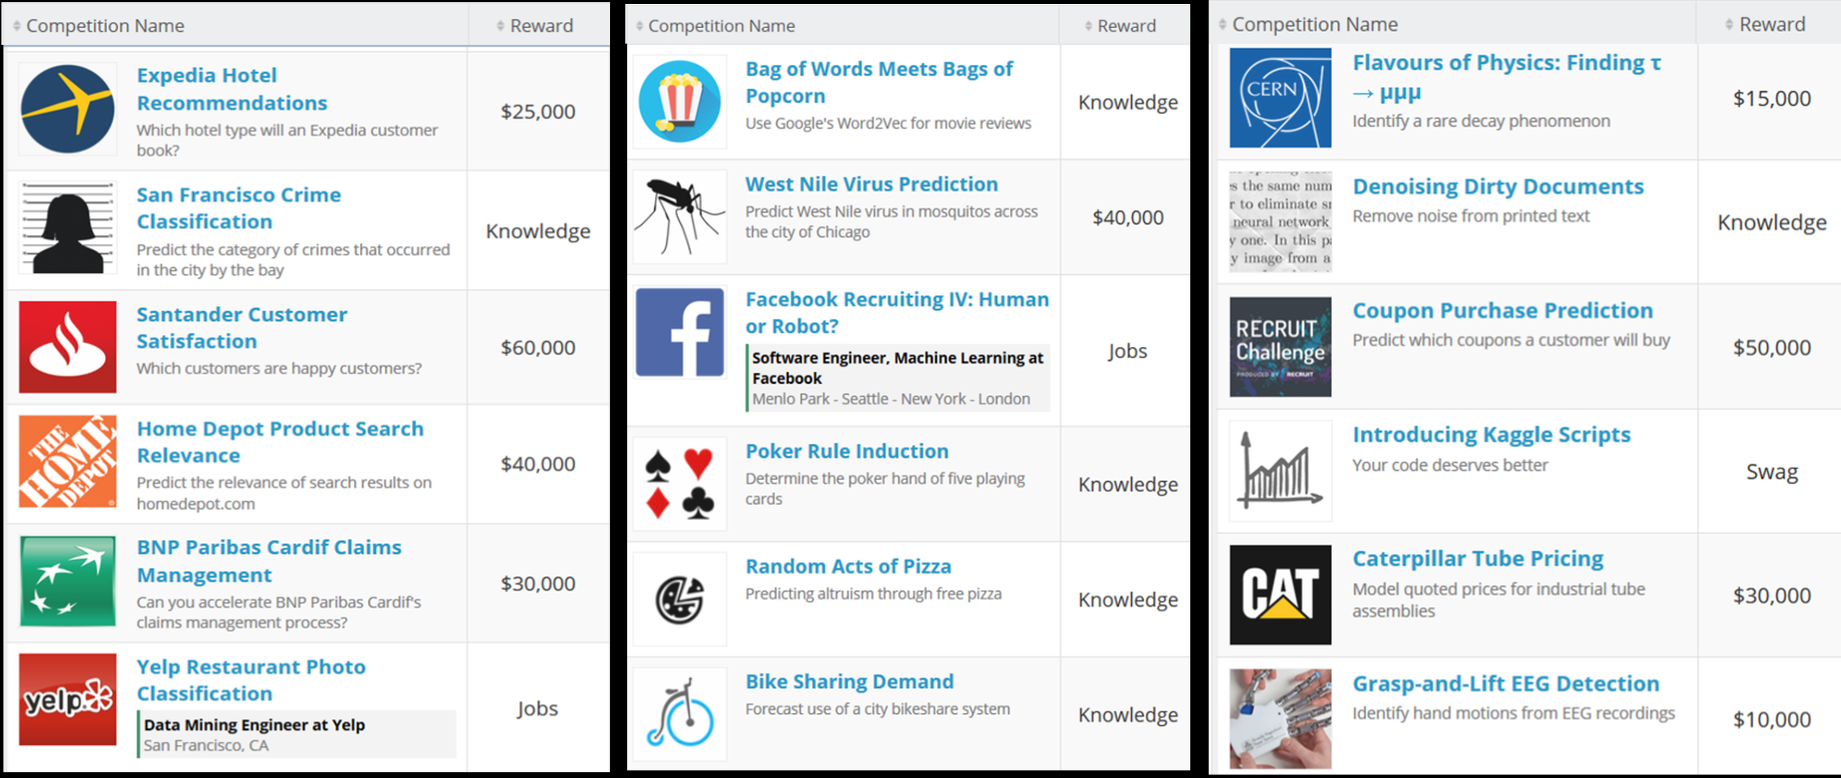
Kaggle discussion
Kaggle:
A Google platform for DS competitions
Sponsored by top organisations
100k+ competitors
Notes:
https://prezi.com/vlkiqfwi6qrf/?utm_campaign=share&utm_medium=copy

Slide 7
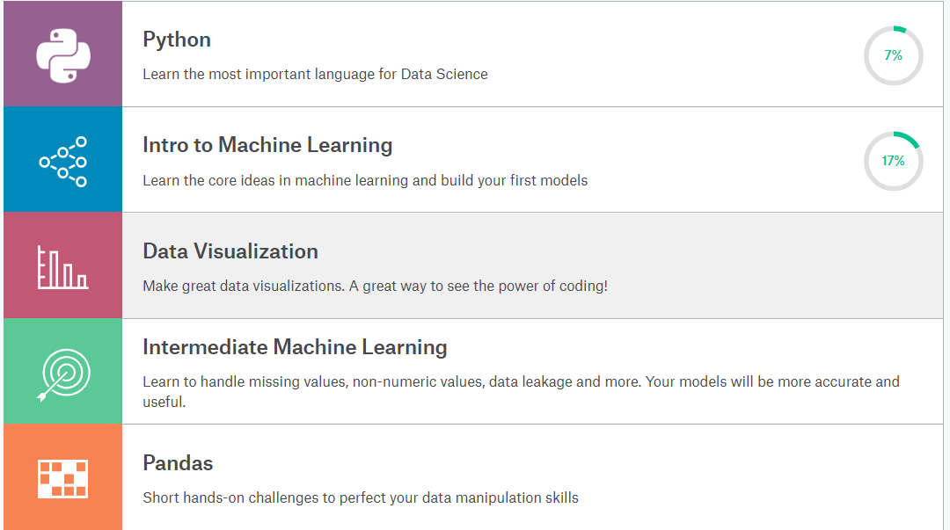
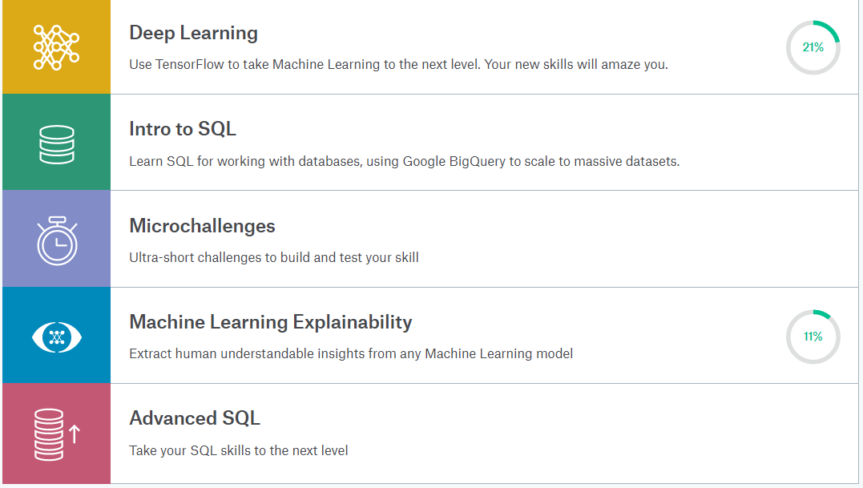

Kaggle discussion
Kaggle as a learning source
https://www.kaggle.com/learn/overview
Notes:
https://www.kaggle.com/learn/overview

Slide 8

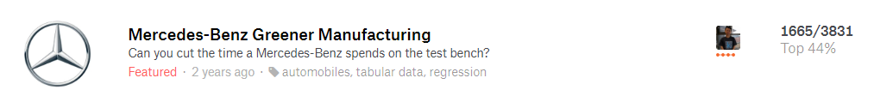



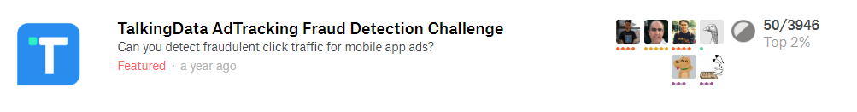

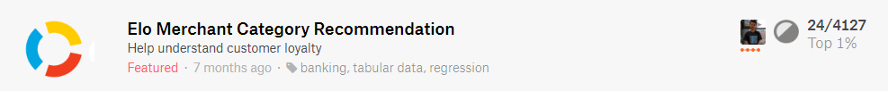


Kaggle discussion
Top 1% 养成
随便玩玩
时间 （20h+ per week)
时间， 套路， 合理组队
时间， 套路+， 脑洞
时间， 套路++， 脑洞+， 抱大腿

Slide 9
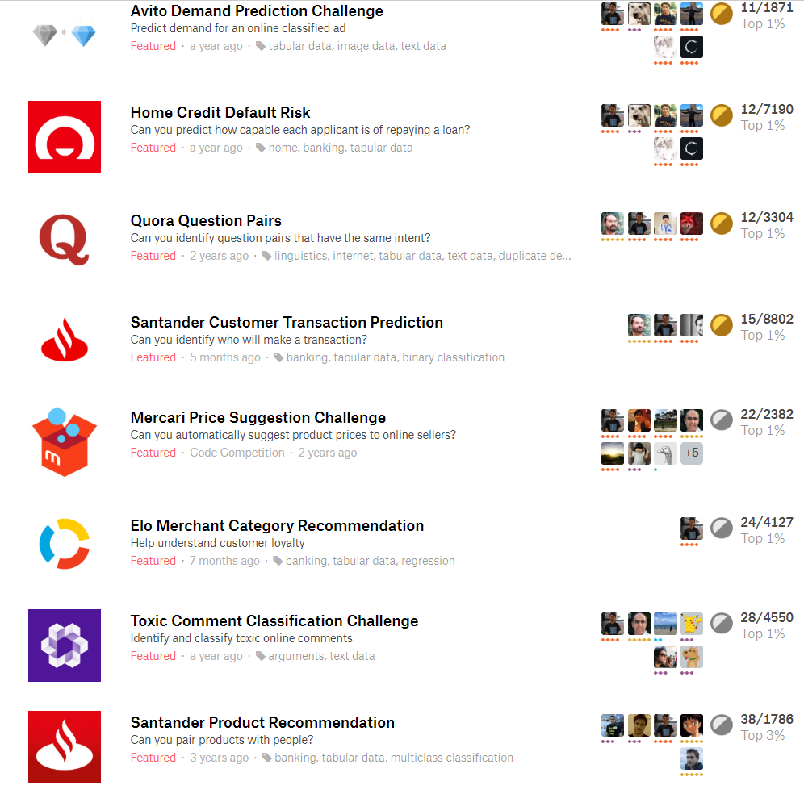
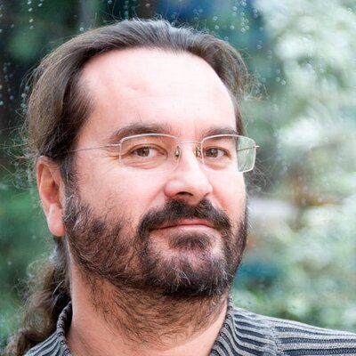
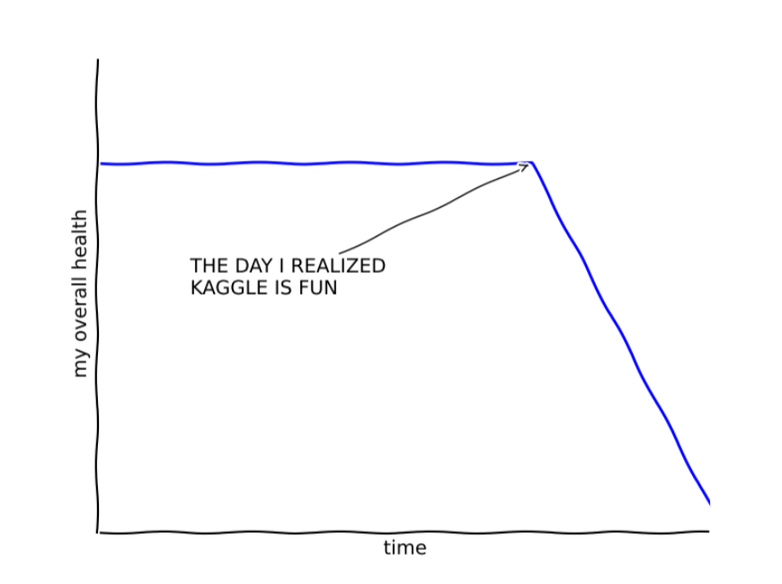
Kaggle discussion
Kaggle is a legal drug
Total 1426 hrs.
Notes:
https://www.kaggle.com/cpmpml/

Slide 10
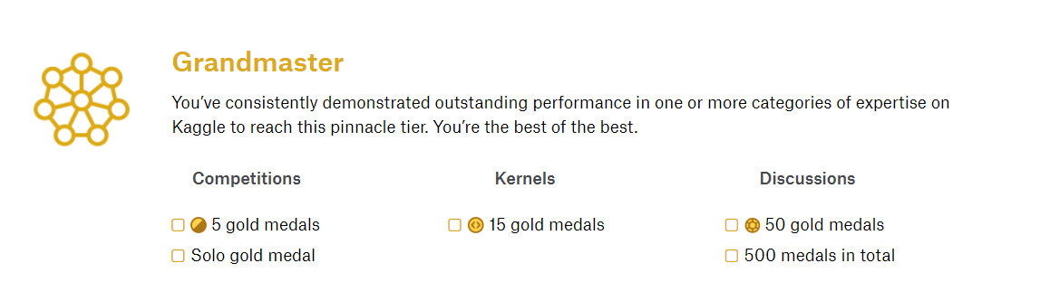
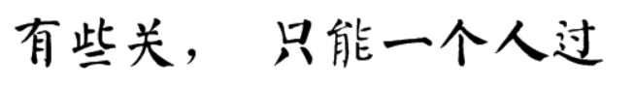
Kaggle discussion

Slide 11


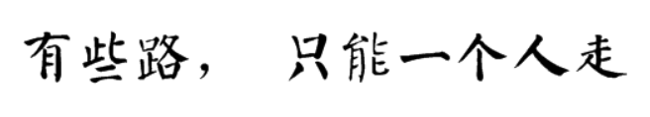
Kaggle discussion
Functional Workflow
Competition Management
人机分工 – Automation

Slide 12
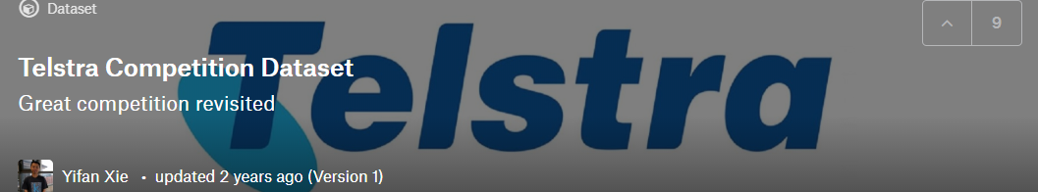
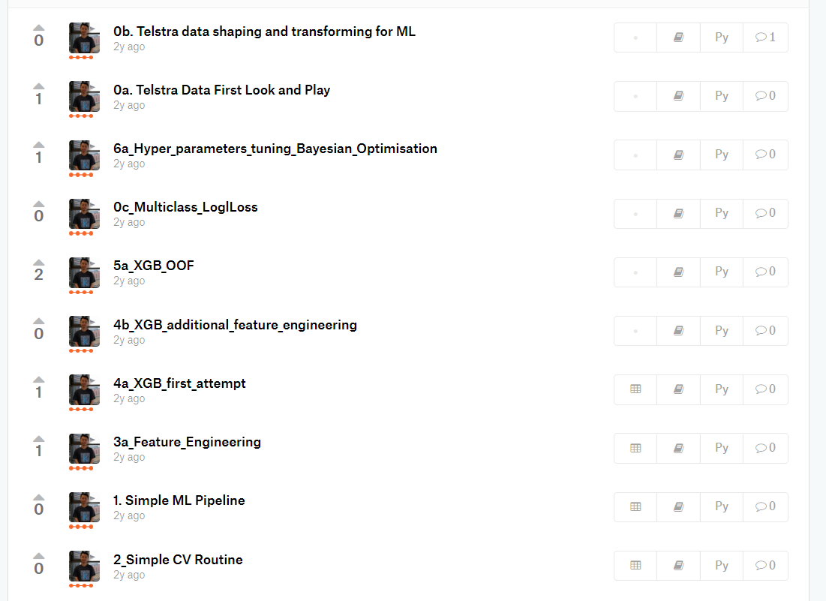
Kaggle discussion
Typical Functional Workflow:
First look – Initial EDA
Understanding evaluation function
Build simple ML models – make submission
Create cross-validation mechanism
Feature engineering & feature selection
In-Depth EDA
Try different algorithms and model selections
Ensemble – Weight Avg, Stacking
https://www.kaggle.com/yifanxie/telstra-competition-dataset/kernels
https://www.kaggle.com/yifanxie/porto-seguro-tutorial-end-to-end-ensemble
Notes:
https://www.kaggle.com/yifanxie/telstra-competition-dataset/kernels
https://www.kaggle.com/yifanxie/porto-seguro-tutorial-end-to-end-ensemble

Slide 13
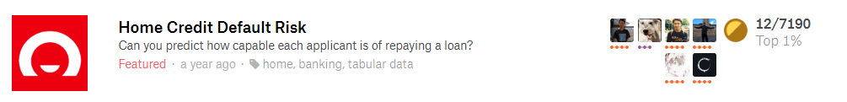
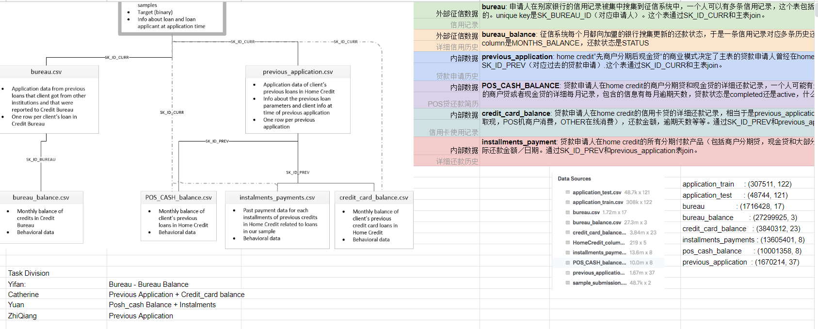
Kaggle discussion
Competition Project Management:
Competition intelligence
Team management
Data dictionary
Experiment results
Features data management
Code version control
Reproducibility
Notes:
https://docs.google.com/spreadsheets/d/1wtIcMtzskUz0SbbotEb-WPuk6KvOV0tc8saghNCwu8o/edit?usp=sharing

Slide 14
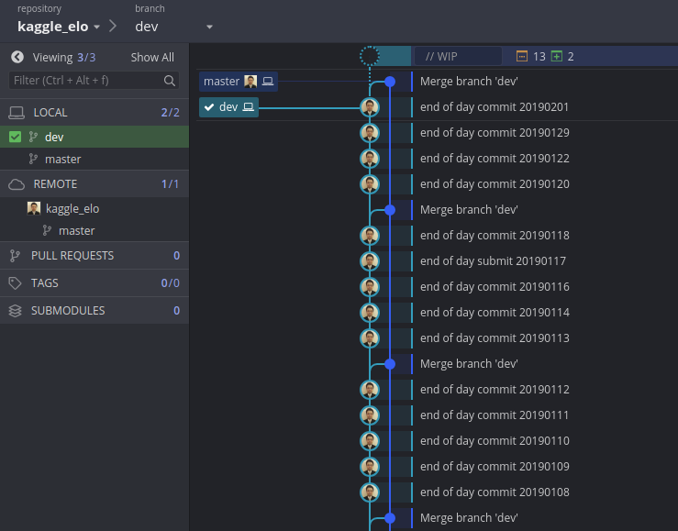
Kaggle discussion
Competition Project Management – What I do:
Competition intelligence
Team management
Data dictionary
Experiment results
Features data management
Code version control
Reproducibility
Google Doc, Slack/Wechat
Git, GitKraken,
script/data backup,
sensible naming convention

Slide 15
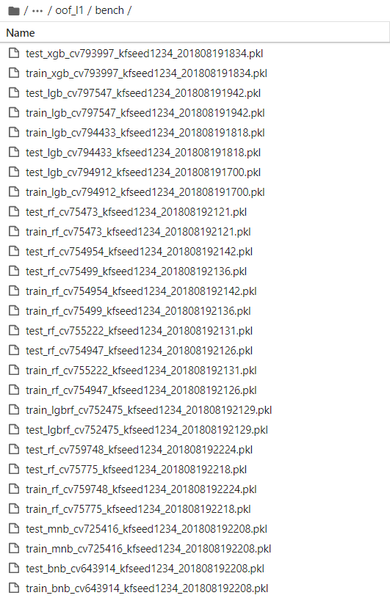
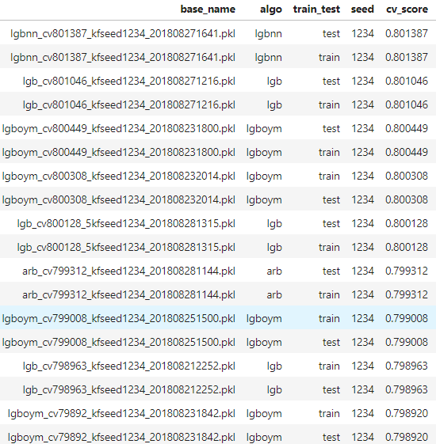
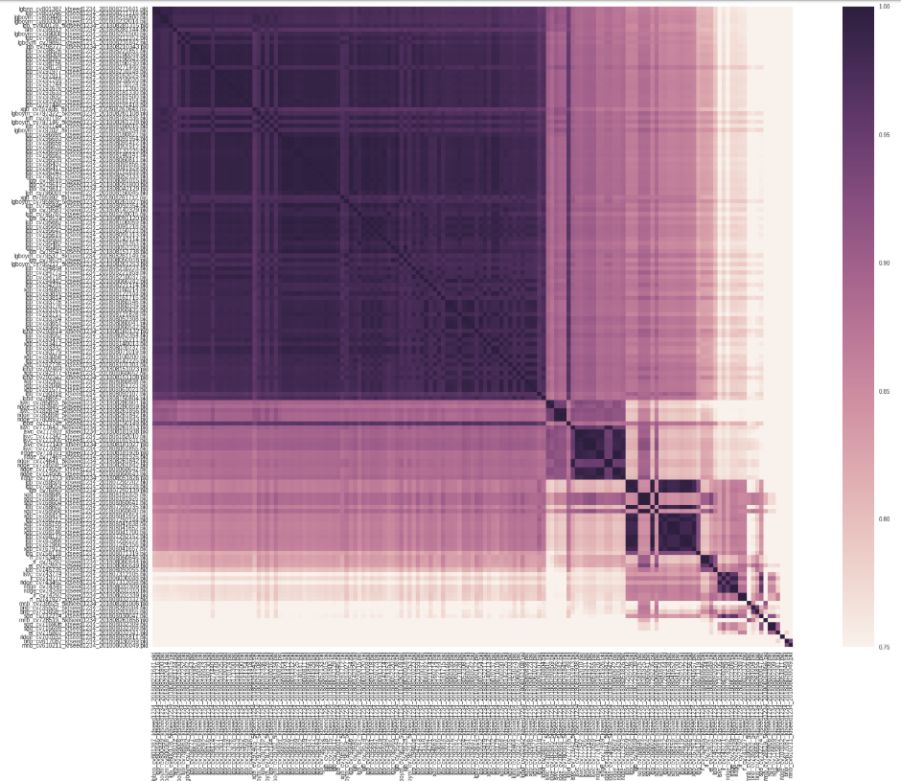
Kaggle discussion
Stacking (don’t try this at work)

Slide 16
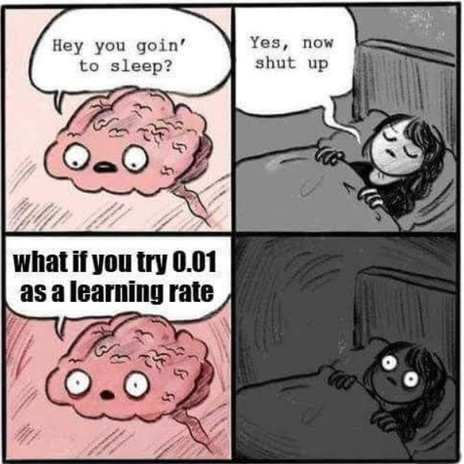
Kaggle discussion
Don’t do this…

Slide 17
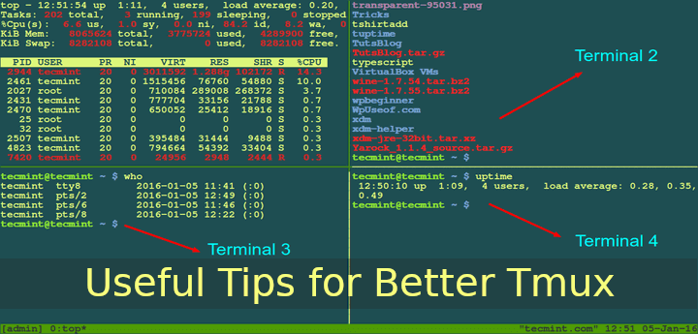
Kaggle discussion
Automation – what I do:
Setup:
A spare machine (preferably not in your bed room)
Kaggle EVERYWHERE – ssh for remote hosting/accessing, Tmux for multplexing
Scripts >>>> Notebooks – Try JupyterLab
Linux >> Windows
Build your own AutoML:
Automate something each competition
Reuse in the next one
Keep building up
Automate as much as you can on your functional workflow

Slide 18
Kaggle discussion
Automation, automation, automation…
Typical tasks for automation:
Automatic feature engineering – aggregation (i.e. groupby) , feature interaction, categorical encoding, etc
Feature selection – Feed forward, Backward elimination, Feature importance permutation
Parameter tuning – Grid-search, Bayesian optimisation, Hyper-opt
Repeated running of large model – i.e. 5millions rows x 500 columns
Deeeeeeeeep learning – most of image competition!!
Notes:
https://www.kaggle.com/c/cat-in-the-dat

Slide 19

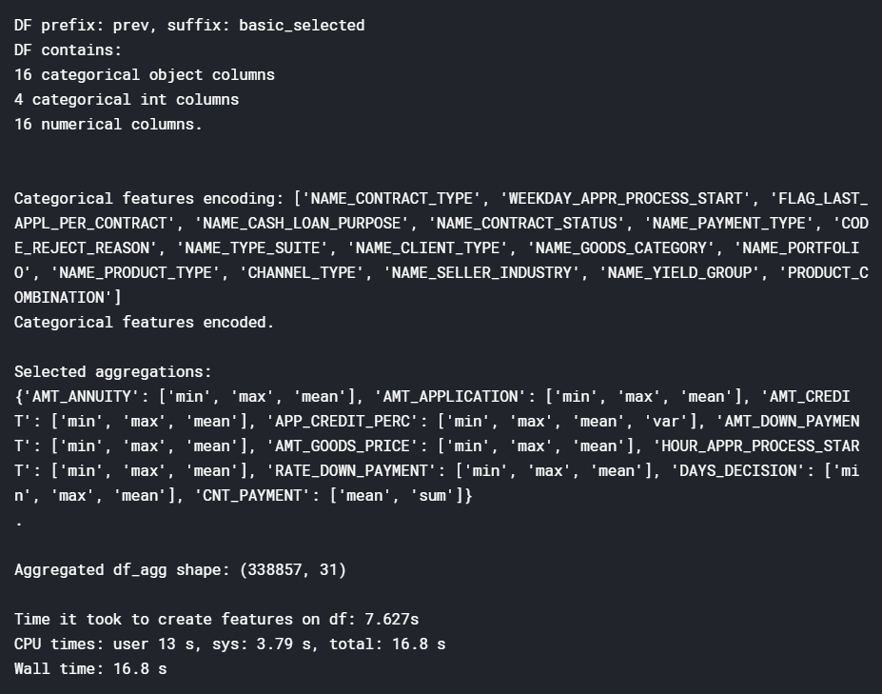
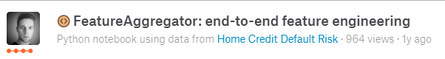
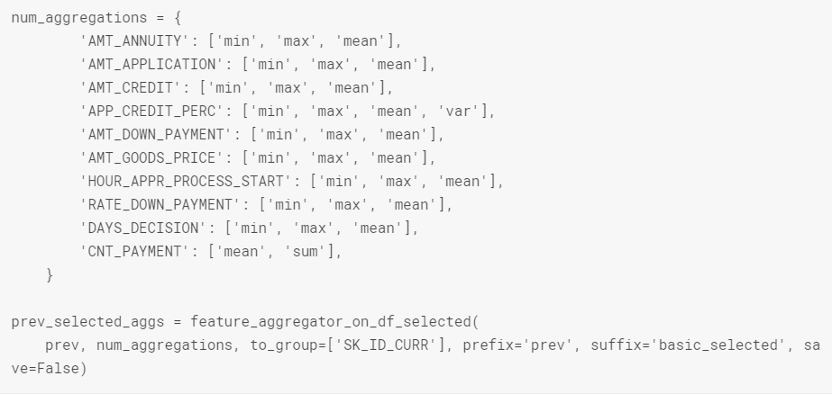
Kaggle discussion
Example: Automatic Aggregation
https://www.kaggle.com/wrosinski/featureaggregator-end-to-end-feature-engineering
Notes:
https://www.kaggle.com/wrosinski/featureaggregator-end-to-end-feature-engineering

Slide 20

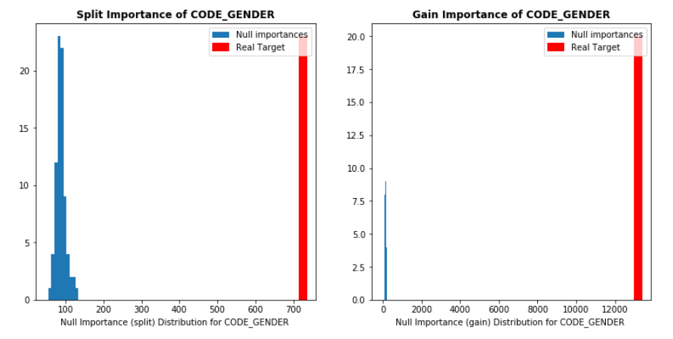
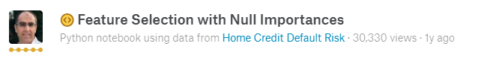
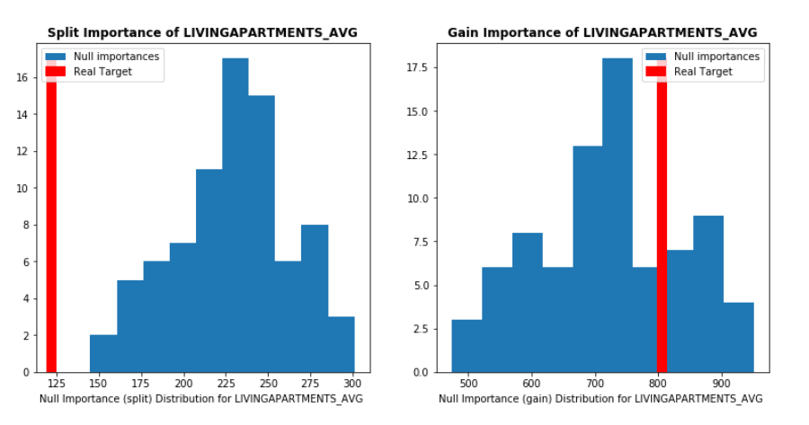
Kaggle discussion
Example: Feature Selection by Importance Permutation
https://www.kaggle.com/ogrellier/feature-selection-with-null-importances
Key Steps:
Build a baseline tree model – RF or GBT
Save feature importance → actual importance
Iterate the following n time (n = 80 in this example)
Random shuffle labels
Build model with shuffled labels
Save n feature importance → null hypo. importance distribution
For each feature, compare “actual importance” against “null hypo. Importance – i.e. compare to mean & max
This create a “permutated importance” for each feature
Notes:
https://www.kaggle.com/ogrellier/feature-selection-with-null-importances

Slide 21
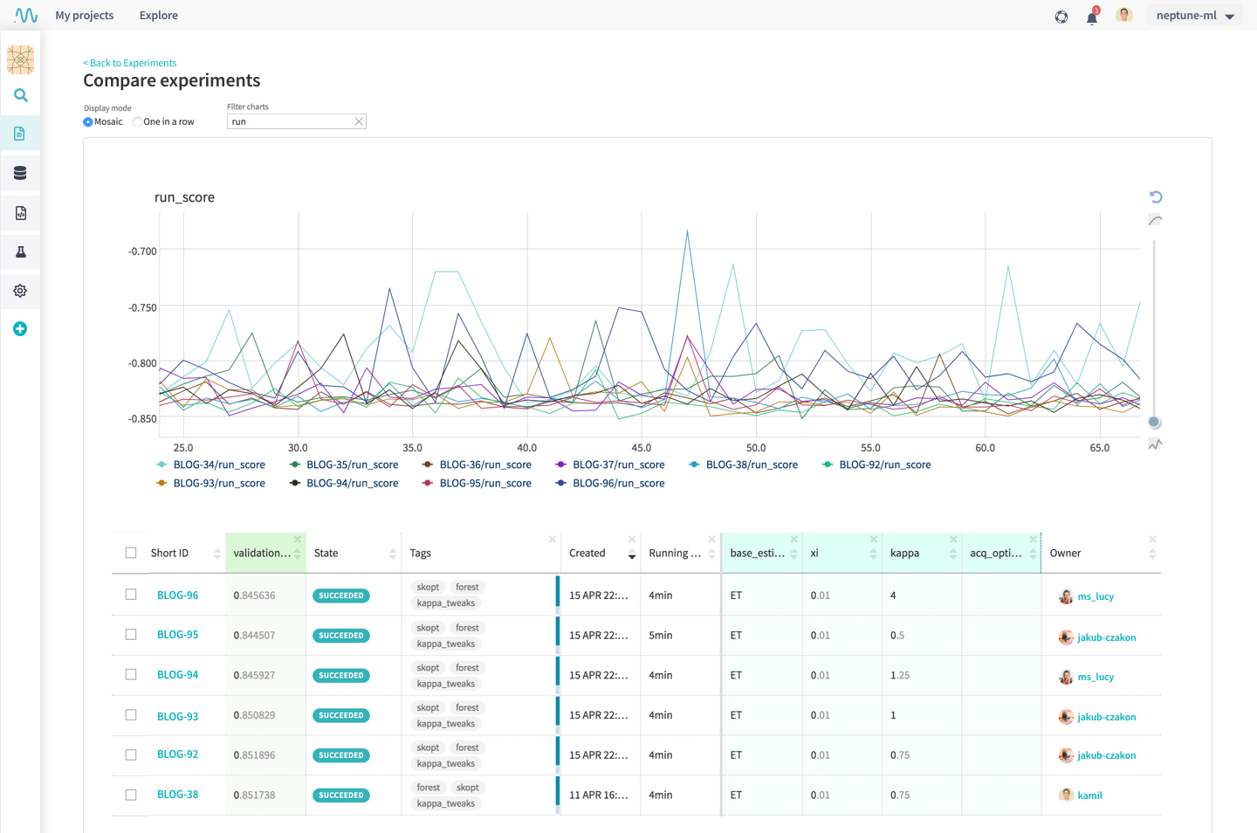
Kaggle discussion
Some Interesting techniques/tools in the last 2 years:
Validation technique for train/test distribution consistency
Adversial validation
DS workflow management
- Neptune, etc
Deep learning
Pytorch
Categorical NN Embedding (feature engineering)
Representation learning (feature engineering)
Transformer – “Attention is all your need” paper
BERT (pretrained model)
Lovaz loss (optimisation function)
Many more….

Slide 22
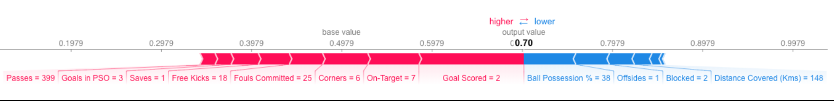
Kaggle discussion
Some Interesting techniques/tools in the last 2 years:
Model interpretation:
SHAP value
https://www.kaggle.com/dansbecker/shap-values
Probability of having Man of the Match award
Notes:
https://www.kaggle.com/dansbecker/shap-values

Slide 23
Kaggle discussion
Kaggle HW requirements:
Just to learn – Kaggle kernel/notebooks (4 CPUs, 16GB RAM, V100 GPU)
Going for gold
Tabular data – CPU/RAM intensive (CPU 8 - 32 cores, RAM >32 GB )
NLP – CPU/RAM/GPU (CPU 8 – 32 cores, RAM 64-128 GB, anything > Nvidia 1080ti)
Images – GPU (CPU 4, RAM 32GB, Nvidia RTX 2018ti, RTX Titan <----> DGX-1 )

Slide 24
Kaggle discussion
How much time?!
Kaggle | Hrs | Ranking | Ranking% | Year
Avito2 | 213 | 11 | 1.00% | 2018
HomeCredit | 110 | 12 | 1.00% | 2018
Quora | 239 | 12 | 1.00% | 2017
Santander Cust. Transaction Prediction | 89 | 15 | 1.00% | 2019
Mecari | 196 | 22 | 1.00% | 2018
Elo | 312 | 24 | 1% | 2019
Toxic | 97 | 28 | 1.00% | 2018
Santander Prod. Recommendation | 169 | 38 | 3.00% | 2016
Talking Data 2 | 110 | 50 | 2.00% | 2018
Instacart | 58 | 79 | 4.00% | 2017
How Much Did It Rain II | 136 | 88 | 15.00% | 2015
Telstra | 225 | 92 | 10.00% | 2016
Bimbo | 192 | 150 | 8.00% | 2016
Talking Data | 16 | 746 | 45.00% | 2016
Expedia | 40 | 1006 | 51.00% | 2016
Porto | 110 | 1236 | 24.00% | 2017
Santander Cust. Satisfaction | 183 | 1262 | 25.00% | 2016
Mercedes | 66 | 1670 | 44.00% | 2017
Total 2562 hrs.

Slide 25
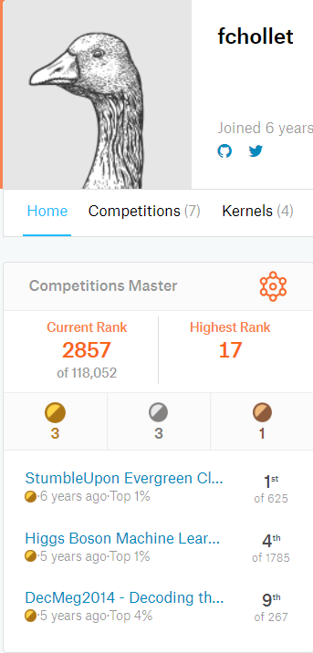
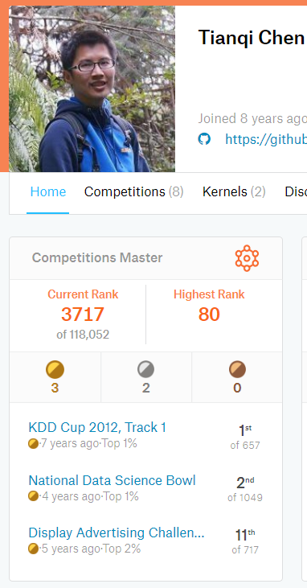
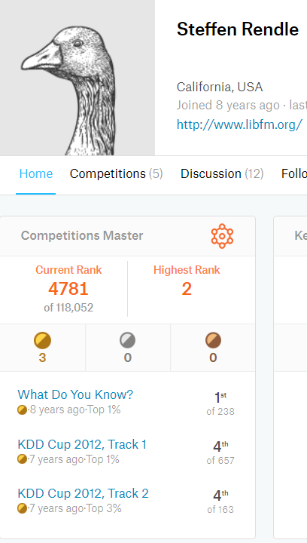
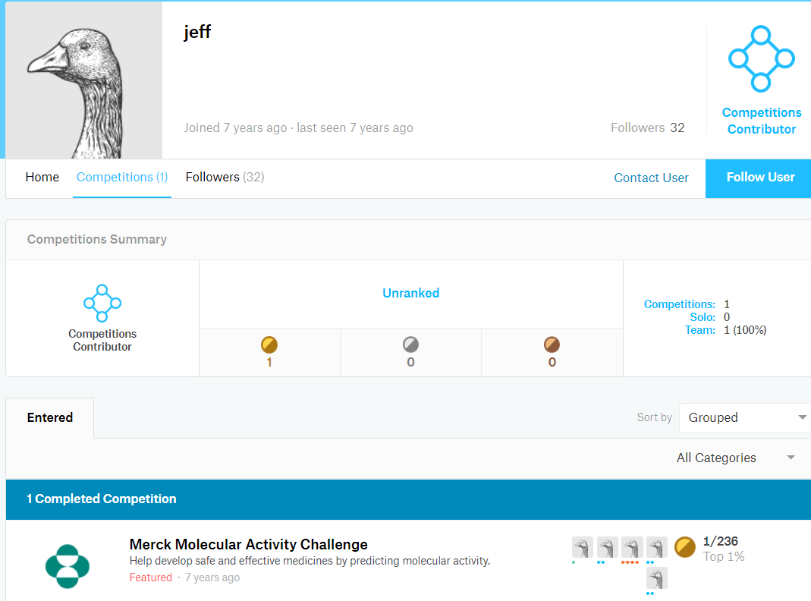
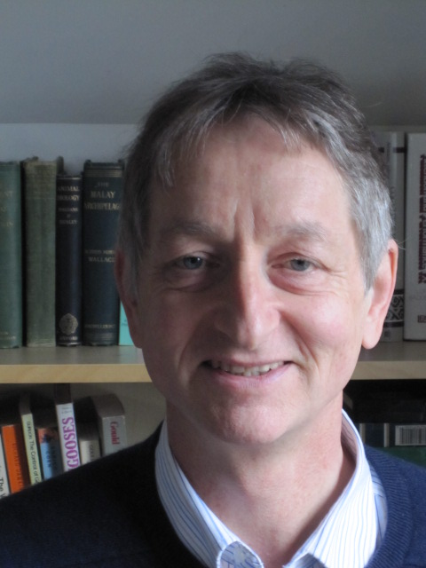



Kaggle discussion
Walking with the giants:

Slide 26
Feedback
https://docs.google.com/forms/d/e/1FAIpQLSdtjst3B-owxCFNYRUWgIgVBHGamVtirPw6otP6i5f8n6qVbA/viewform?usp=sf_link

